Slide 1
Information System for All-India Coordinated Research Projects
A. Dhandapani
Principal Scientist (Statistics/Computer Applications)

Slide 2
All India Coordinated Research Projects
An important arm in Agricultural Research in the country
Unique – Central Research Institutes (ICAR) and State Agricultural Universities work as a team
Started in 1957 for improvement of agricultural crops, extended to crop & animal husbandry, Agricultural Engineering, etc.
More than 70

Slide 3
AICRP - Structure
Coordinating Centre
  Planning, Monitoring and reporting; Fund Allocation
  Release Proposals/Technology validation
Cooperating/Voluntary Centres/ NGOs/Private Industries
  Divided into Zones/season/hotspots
  Execution of trials

Slide 4
Features of Experiments (Crops)
Trials
  Crop Improvement (Initial, Advanced)
  Crop Protection
  Crop Production
  Others
Number of trials planned – depends on crop (Rice ~40 trials; Maize ~30 trials)
Statistical Designs -Augmented; Block Designs; Split Plot

Slide 5
Reporting
Simple ANOVA
Table of Means with ranks of treatments across locations; P-value; Grand Mean, CD Value & CV
Zone-wise Analysis a.k.a. Pooled Analysis

Slide 6
Information System for AICRPs
  facilitates planning of experiments at AICRP
  maintains information about the experiments at a centralized place
  allows enter/upload experimental data during the course of experiment (or at the end)
  ability to carry out appropriate statistical analysis and automate uniform reporting process
  flexible/generic so that any AICRP can use
  aims at standardization of data collection and statistical analysis across AICRPs

Slide 7
AICSIP automation System
All India Coordinated Sorghum Improvement Project (AICSIP)
Public/General Users
Users at different Location
AICRP Automation System
Database
Head/PC/PD
Admin
Experiment In-charges

Slide 8
Roles of different users in AICSIP Information Systems
Role Name | Role Tasks
Experiment In-charges | Plan and create Experiments; Data quality checking, approve data submitted, Analysis
Experimenters | Conducting experiments; download datasheets/upload datasheets
Group Head | Monitoring
Admin | Back-end works

Slide 9
Modules in AICSIP
Experiment Creation Module
Data upload & Scrutiny Module
Analysis Module
Management Module
Admin Module

Slide 10
Information Flow in AICSIP
Experiment I/C
Start
New/Edit Experiment
Final Experiment
Randomize
Trial Layouts
Experiment Creation Module
Review
Reports
Analyze trial
Accept
Upload Trial Data
Download data sheets
Reject
Analysis and Reporting Module
Data Handling Module
Experiment I/C
Experimenters

Slide 11
Features implemented
New Lines Database; Selection of entries in initial/advanced trials from the database
Random Coding of lines (Replication-wise coding; same code across replication)
Randomized Layouts for different designs (CRD; RBD; Alpha; Split Plot; Factorial Experiments)
Datasheet generation
Data upload
Statistical Analysis and Reporting

Slide 12
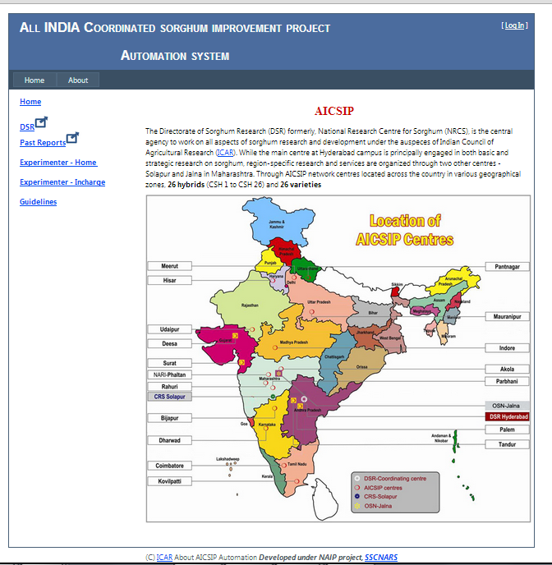
www.aicsip.naarm.org.in

Slide 13
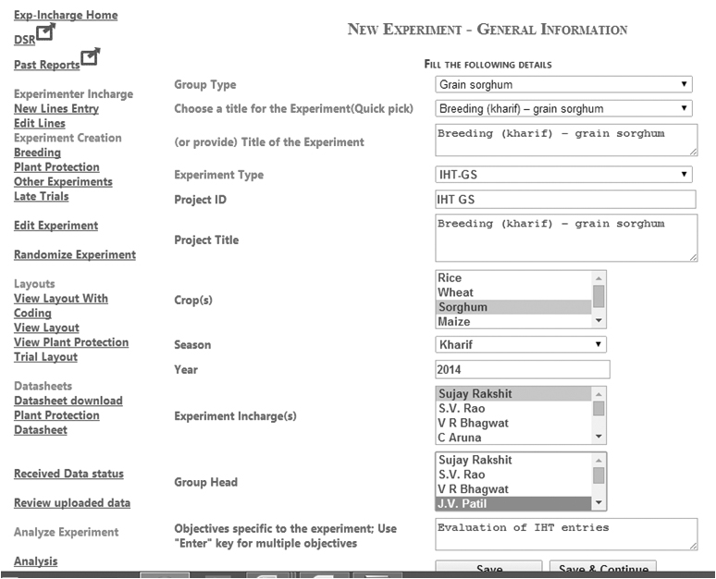
Experiment Creation

Slide 14
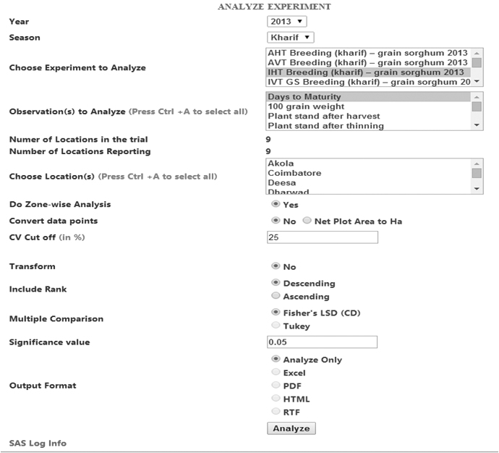
Analysis Interface

Slide 15
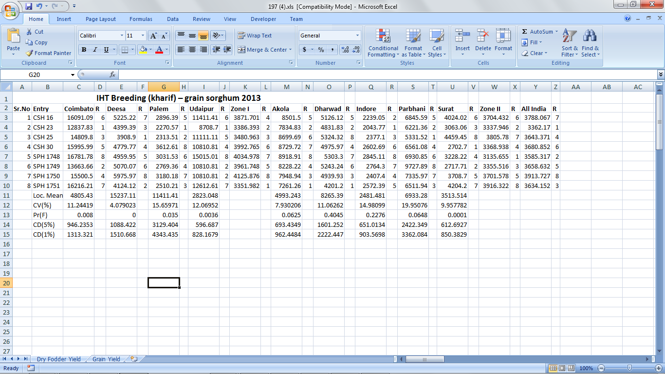
Output Excel File

Slide 16
Technologies used
Server Side – ASP.NET
Database – MS-SQL Server
XML data types
Analysis Module
  SAS® Macros/Stored Process
Other Libraries used:
  ExcelLibrary
  PDFSharp

Slide 17
Analysis Module
All analysis through SAS®
Uses SAS® Macros/Stored Procedures
Customized outputs as per requirement
Output in Excel as per user choice

Slide 18
AICRP-VC Automation System
www.iasri.res.in/aicrpvc

Slide 19
Experiment Data Repository
Experiment Data should be
  Accessible (secured)
  Available (digital)
  Verified
  Structured form
Required to develop suitable semantic components to describe experiments

Slide 20
Semantic Components for Coordinated Trials - Experiment
General
  Created Username, Created Date, Project Details, experiment title, type etc.
Associated People
Locations
  Location Names and their in-charges
Treatment Details
  Factors and levels
Statistical Design
  Design Name, Parameters

Slide 21
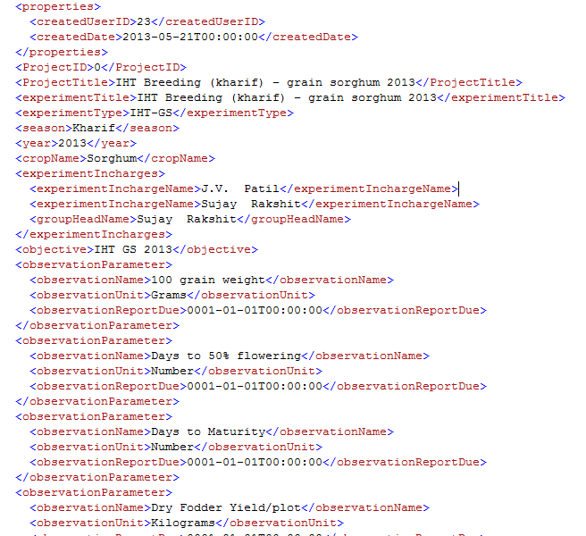
XML for Experiments

Slide 22
Semantic Component for Random Codes
Coding Details
  Replication
  Original Treatment Detail
  Random Code
Same Markup can be used for same code across replications/no coding (set Random code = -1)

Slide 23
Random Code markup

Slide 24
Semantic Component for Random Layout
Location Name
Replication
Random Code of Treatment Allotted in every experimental unit

Slide 25
Random Layout markup

Slide 26
Unit Level data for coordinated Trials data
Along with semantic components, actual data from experiments can be stored in database
Typically in Long form (Location, treatment, rep, parameter name, data value)
Follows the ICAR Data Management Policy for unit-level data

Slide 27
Way forward
Establish automation system for other AICRPs
  Two from each SMD planned under KRISHI
Similar semantic components for other experiments
Visualization

Slide 28
Six Repositories in KRISHI
Technology Repository
Geo portal
Publication Repository
Experimental Data Repository
Survey Data Repository
Observational Data Repository

Slide 29




Thanks

